Slide 1
Java - Strings

Slide 2
Constructing Strings
String newString = new String(stringLiteral);
String message = new String("Welcome to Java");
Since strings are used frequently, Java provides a shorthand initializer for creating a string:
String message = "Welcome to Java";

Slide 3
Strings Are Immutable
A String object is immutable; its contents cannot be changed. Does the following code change the contents of the string?
String s = "Java";
s = "HTML";

Slide 4

Trace Code
String s = "Java";
s = "HTML";

Slide 5
Interned Strings
Since strings are immutable and are frequently used, to improve efficiency and save memory, the JVM uses a unique instance for string literals with the same character sequence. Such an instance is called interned. For example, the following statements:

Slide 6
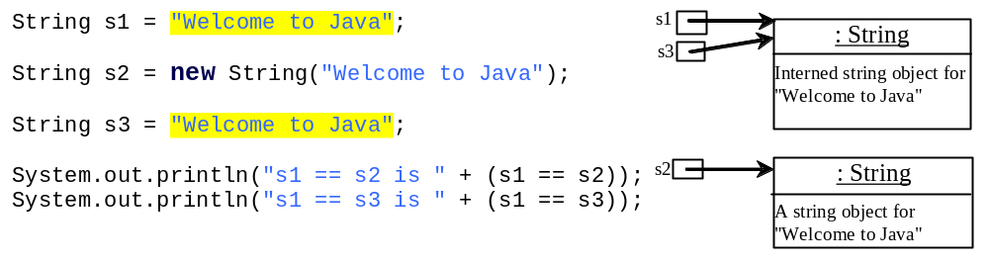
Examples
display
s1 == s2 is false
s1 == s3 is true
A new object is created if you use the new operator.
If you use the string initializer, no new object is created if the interned object is already created.

Slide 7
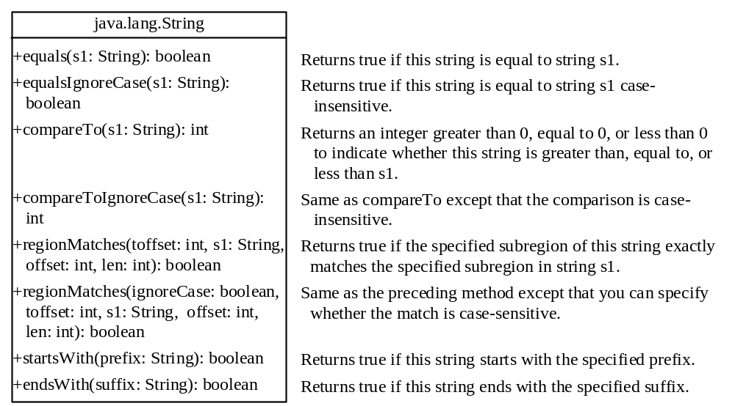
String Comparisons

Slide 8
String Comparisons
equals
String s1 = new String("Welcome“);
String s2 = "welcome";
if (s1.equals(s2)){
// s1 and s2 have the same contents
}
if (s1 == s2) {
// s1 and s2 have the same reference
}

Slide 9
String Comparisons, cont.
compareTo(Object object)
String s1 = new String("Welcome“);
String s2 = "welcome";
if (s1.compareTo(s2) > 0) {
// s1 is greater than s2
}
else if (s1.compareTo(s2) == 0) {
// s1 and s2 have the same contents
}
else
// s1 is less than s2

Slide 10
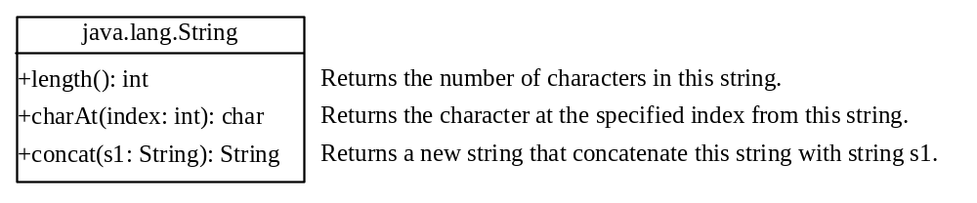
String Length, Characters, and Combining Strings

Slide 11
Finding String Length
Finding string length using the length() method:
message = "Welcome";
message.length() (returns 7)

Slide 12
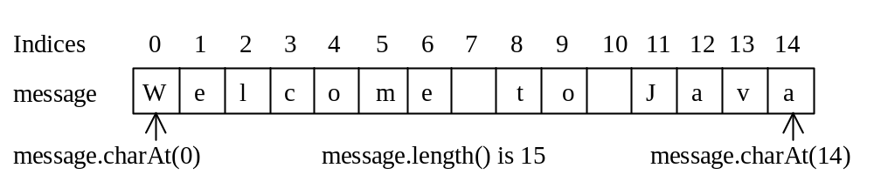
Retrieving Individual Characters in a String
Do not use message[0]
Use message.charAt(index)
Index starts from 0

Slide 13
String Concatenation
String s3 = s1.concat(s2);
String s3 = s1 + s2;
s1 + s2 + s3 + s4 + s5 same as
(((s1.concat(s2)).concat(s3)).concat(s4)).concat(s5);

Slide 14
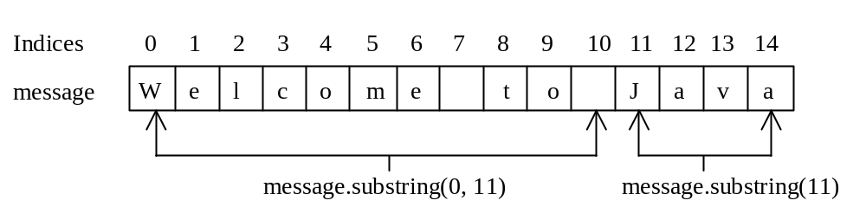
Extracting Substrings
You can extract a single character from a string using the charAt method. You can also extract a substring from a string using the substring method in the String class.
String s1 = "Welcome to Java";
String s2 = s1.substring(0, 11) + "HTML";

Slide 15
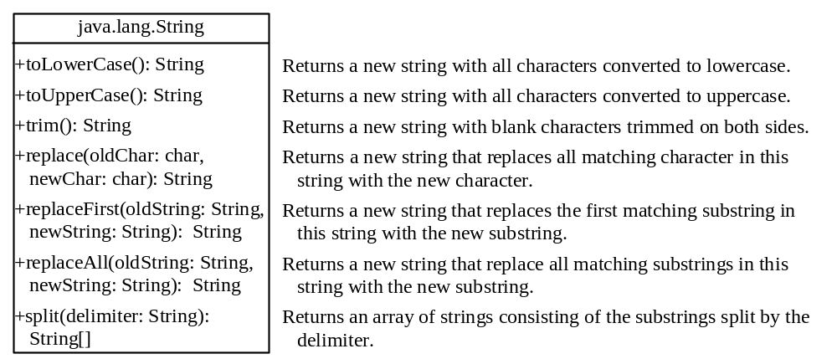
Converting, Replacing, and Splitting Strings

Slide 16
Examples
"Welcome".toLowerCase() returns a new string, welcome.
"Welcome".toUpperCase() returns a new string, WELCOME.
" Welcome ".trim() returns a new string, Welcome.
"Welcome".replace('e', 'A') returns a new string, WAlcomA.
"Welcome".replaceFirst("e", "AB") returns a new string, WABlcome.
"Welcome".replaceAll("e", "AB") returns a new string, WABlcomAB.
"Welcome".replaceAll("el", "AB") returns a new string, WABcome.

Slide 17
Splitting a String
String[] tokens = "Java#HTML#Perl".split("#");
for (int i = 0; i < tokens.length; i++)
System.out.print(tokens[i] + " ");
displays
Java HTML Perl

Slide 18
Matching, Replacing and Splitting by Patterns
The replaceAll, replaceFirst, and split methods can be used with a regular expression.
For example, the following statement returns a new string that replaces $, +, or # in "a+b$#c" by the string NNN.
String s = "a+b$#c".replaceAll("[$+#]", "NNN");
System.out.println(s);
Here the regular expression [$+#] specifies a pattern that matches $, +, or #. So, the output is aNNNbNNNNNNc.

Slide 19
Matching, Replacing and Splitting by Patterns
The following statement splits the string into an array of strings delimited by some punctuation marks.
String[] tokens = "Java,C?C#,C++".split("[.,:;?]");
for (int i = 0; i < tokens.length; i++)
System.out.println(tokens[i]);

Slide 20
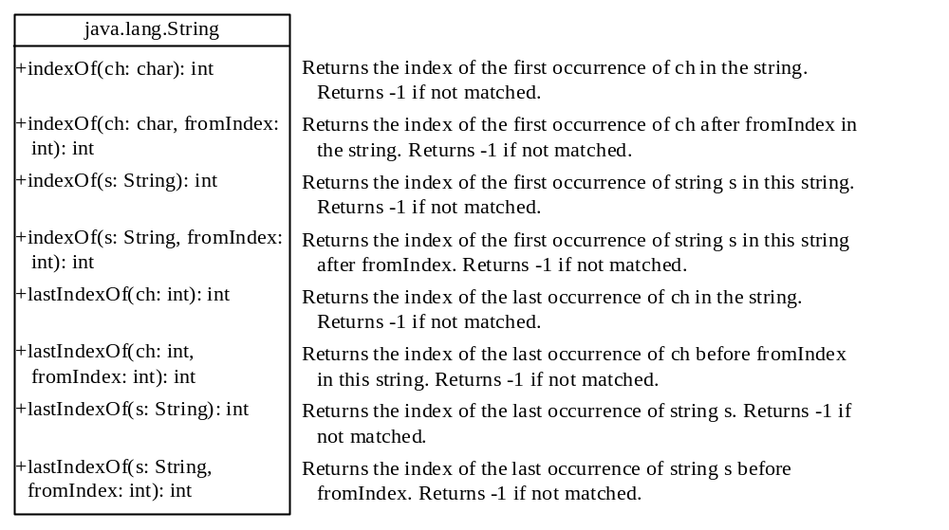
Finding a Character or a Substring in a String

Slide 21
Finding a Character or a Substring in a String
"Welcome to Java".indexOf('W') returns 0.
"Welcome to Java".indexOf('x') returns -1.
"Welcome to Java".indexOf('o', 5) returns 9.
"Welcome to Java".indexOf("come") returns 3.
"Welcome to Java".indexOf("Java", 5) returns 11.
"Welcome to Java".indexOf("java", 5) returns -1.
"Welcome to Java".lastIndexOf('a') returns 14.

Slide 22
Convert Character and Numbers to Strings
The String class provides several static valueOf methods for converting a character, an array of characters, and numeric values to strings.
These methods have the same name valueOf with different argument types char, char[], double, long, int, and float.
For example, to convert a double value to a string, use String.valueOf(5.44).

Slide 23
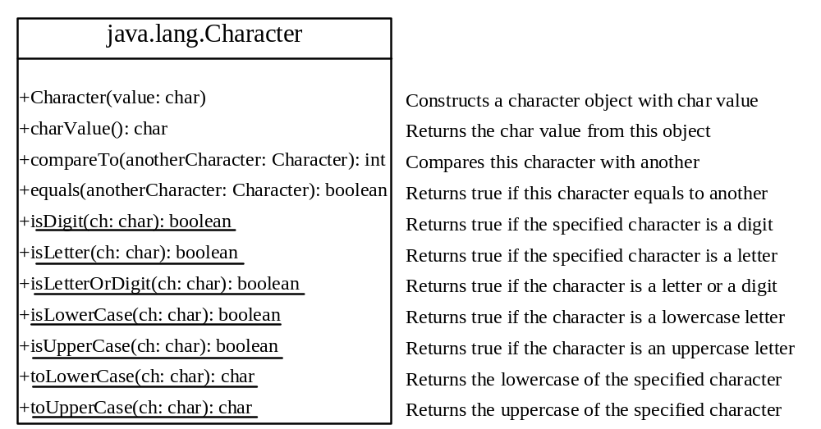
The Character Class

Slide 24
Examples
Character charObject = new Character('b');
charObject.compareTo(new Character('a')) returns 1
charObject.compareTo(new Character('b')) returns 0
charObject.compareTo(new Character('c')) returns -1
charObject.compareTo(new Character('d') returns –2
charObject.equals(new Character('b')) returns true
charObject.equals(new Character('d')) returns false

Slide 25
StringBuilder and StringBuffer
The StringBuilder/StringBuffer class is an alternative to the String class.
In general, a StringBuilder/StringBuffer can be used wherever a string is used.
StringBuilder/StringBuffer is more flexible than String. You can add, insert, or append new contents into a string buffer, whereas the value of a String object is fixed once the string is created.

Slide 26
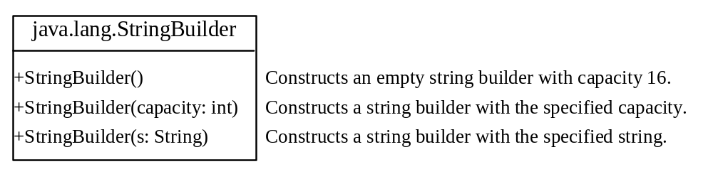
StringBuilder Constructors

Slide 27

Modifying Strings in the Builder

Slide 28
Examples
StringBuilder stringBuilder = new StringBuilder();
stringBuilder.append(“Welcome to Java");
stringBuilder.insert(11, "HTML and ");
stringBuilder.delete(8, 11) changes the builder to Welcome Java.
stringBuilder.deleteCharAt(8) changes the builder to Welcome o Java.
stringBuilder.reverse() changes the builder to avaJ ot emocleW.
stringBuilder.replace(11, 15, "HTML") changes the builder to Welcome to HTML.
stringBuilder.setCharAt(0, 'w') sets the builder to welcome to Java.

Slide 29

toString, capacity, length, setLength, and charAt Methods

